Slide 1
DESIGNING A SOCIAL MEDIA APP Socialize
<<A better way to connect people>>

Slide 2
List of members
01
05
02
03
04
Martine Carole
Tima Claude
Emmanuel
Bryan
06
Nde Dilan
07
King
Yann Rael
08
Rosita

Slide 3
What problem are we solving?
01
Existing social media platforms often fall short in meeting the distinct needs of school communities, lacking essential features such as robust content moderation, targeted networking, and specific communication tools.
Socialize addresses this gap by developing a customized social media solution, designed to foster a secure and enriching digital ecosystem. By prioritizing the unique requirements of schools, Socialize ensures a productive and safe online space for educational communities.

Slide 4
How do we plan to solve that problem?
02
To address it, we choose to adopt the SCRUM methodology. By adopting the Scrum methodology,us the Socialize project team can leverage its strengths to deliver a high-quality, user-centric social media platform that meets the unique needs and requirements of the school community.

Slide 5
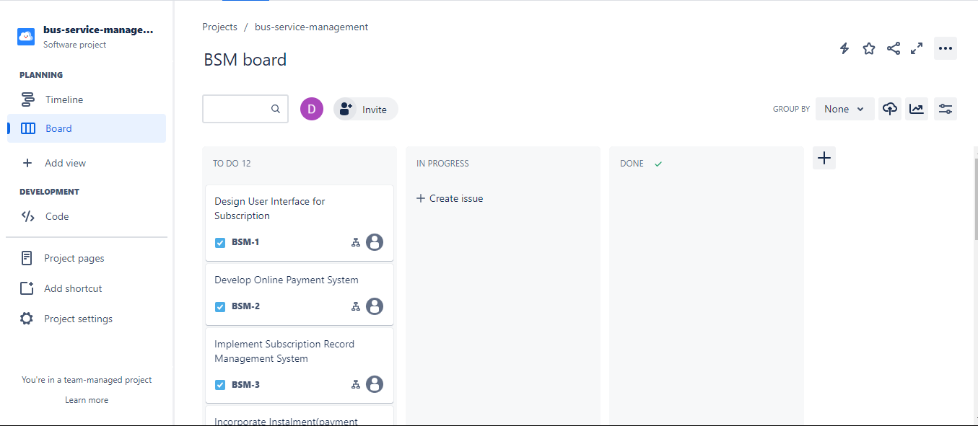
Creating a schedule for the tasks and activities.
03
Every project need a schedule, it’s why our team used the Jira software and its tools to create our own and to manage the project.
SocialMedia Application : Socialize Jira

Slide 6
High Level Design of the complete project
04
We understand that developing a comprehensive software solution demands significant effort, which is why we began with designing the high-level architecture of our system to thoroughly grasp its intricacies and capture all essential requirements.
Next Slide to see it

Slide 7
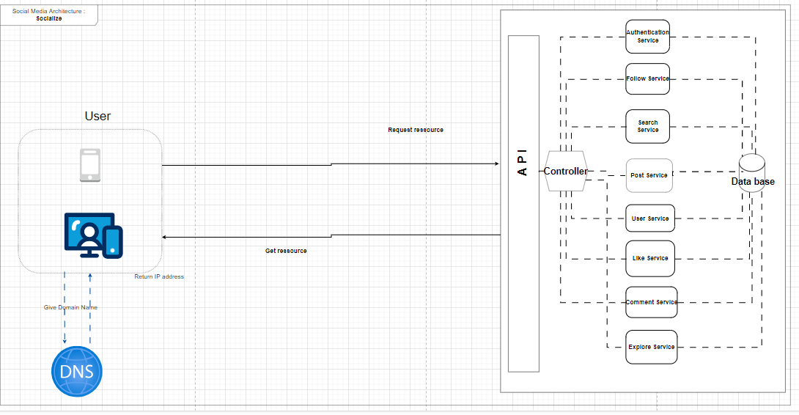
< High Level View Of the Proposed Solution >

Slide 8
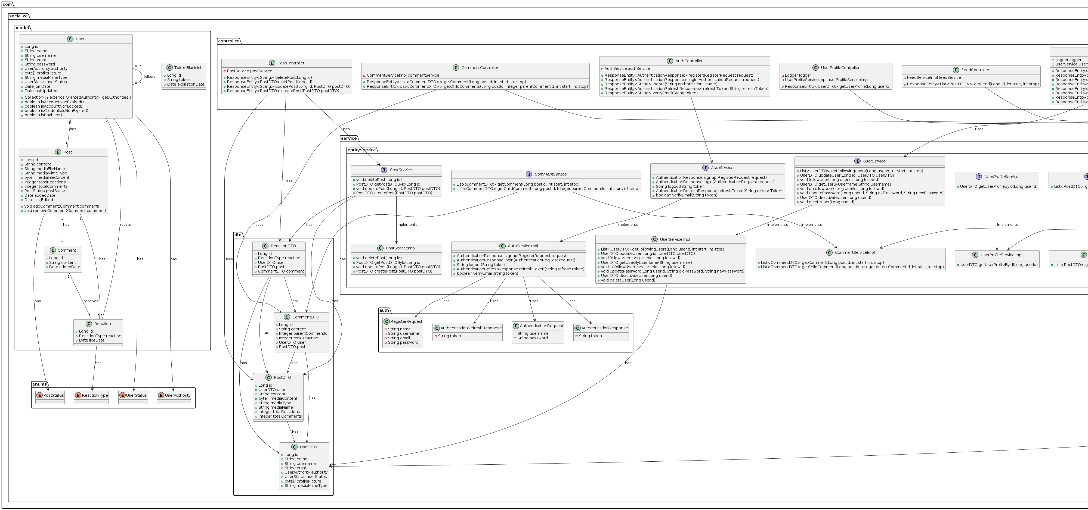
<Class Diagram Of the Proposed Solution>.

Slide 9
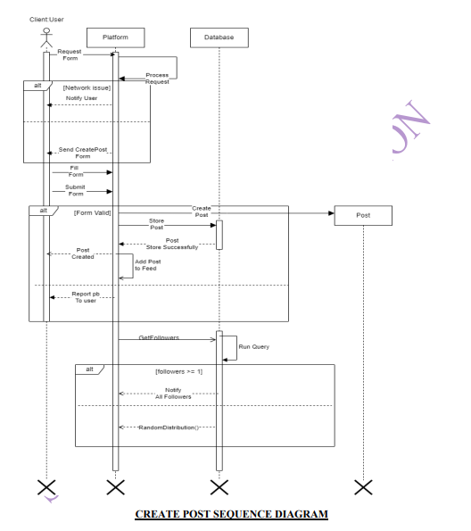
Sequence Diagram

Slide 10
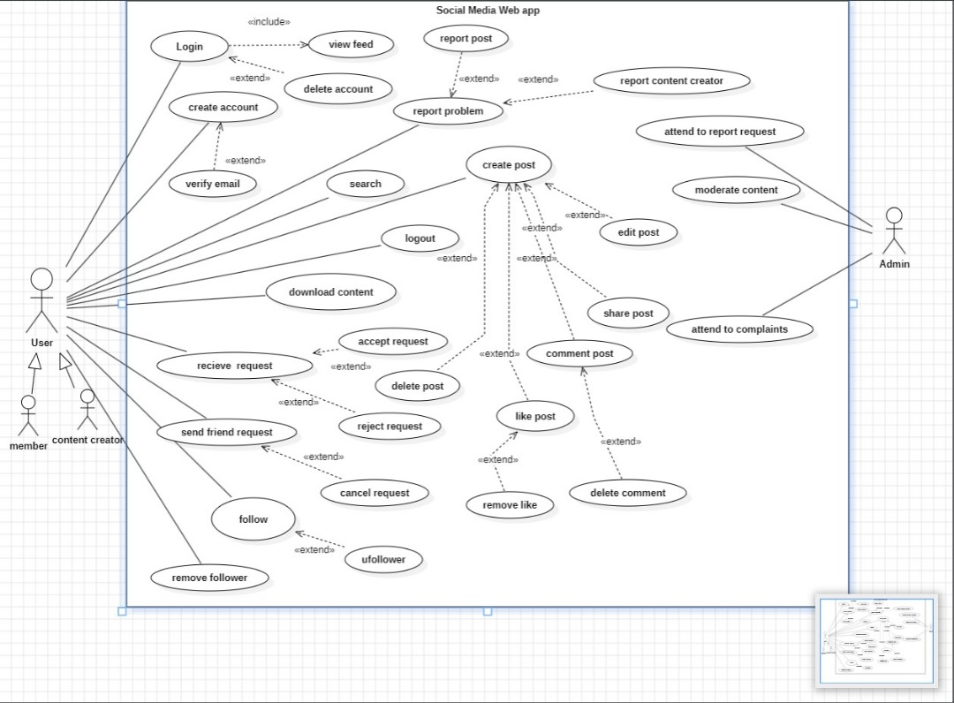
Use Case Diagram

Slide 11
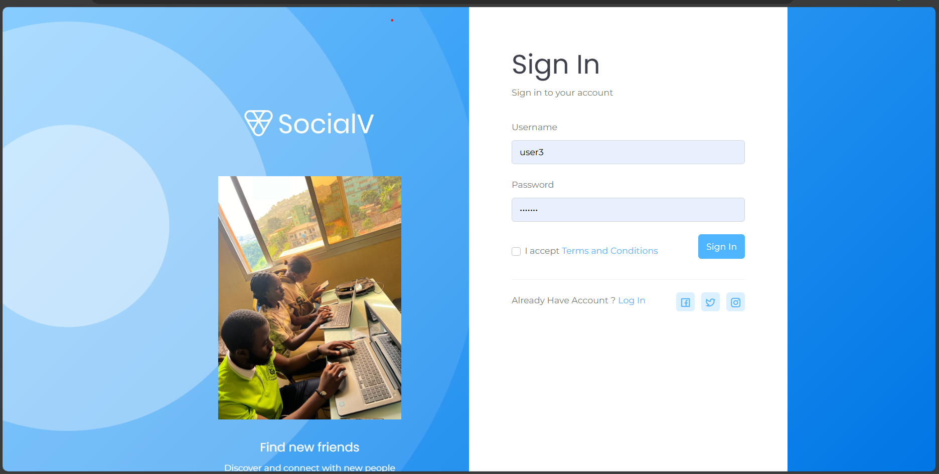
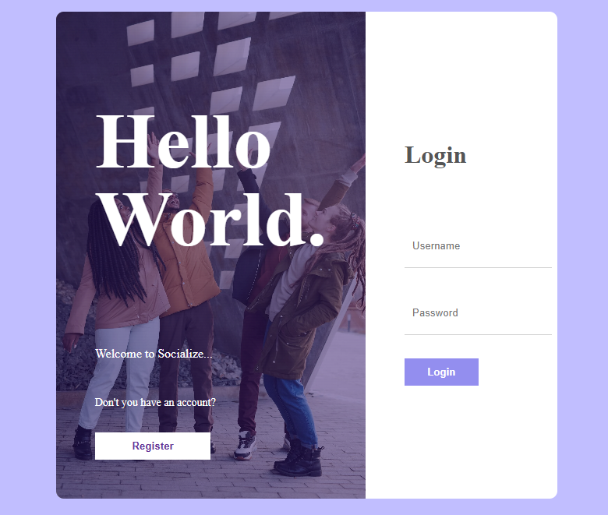
What are the results?
The following is the list of what we were able to do .
Complete and working
Login and Registration System .

Slide 12
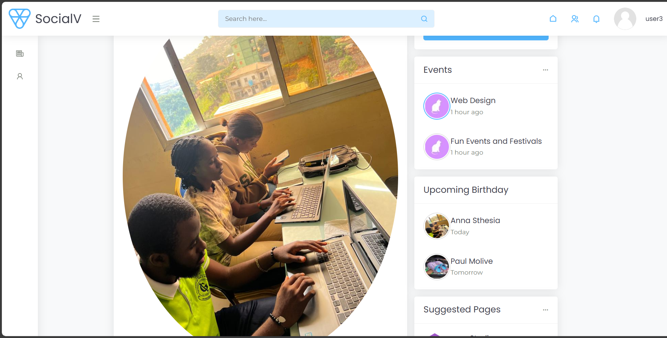
Ready to use Home Page?
The following is the list of what we were able to do .
Complete and working
Login and Registration System .

Slide 13
What was the Challenges?
Challenges Encountered and How They Were Overcome:
• Backend: Application unable to run caused by the database connectivity Used Xampp and/or MYSQL server
• Frontend: Uploading an image (post by a user)
• Making the Screens responsive
• Combining the work using VCS

Slide 14
Let’s look for the Future🚀
As we continue to evolve and refine the Socialize platform, we are committed to incorporating features that enhance the user experience and meet the growing needs of educational communities.
Enhanced Educational Tools:
Development of advanced classroom management features.
Integration of interactive tools for assignments and assessments.
Support for virtual classrooms and remote learning capabilities.
User-Centric Enhancements:
Introduction of personalized user settings.
Advanced privacy controls and security features.
Enhanced user profile customization options.

Slide 15
End!
Thanks for your kind attention.

